Slide 1
The Flyweight Pattern
Hazırlayan
Mehmet Cemil AYDOĞDU

Slide 2
The Flyweight Pattern
Problem:
In situations where large numbers of similar objects are created there might be some performance problems because of high memory usage.

Slide 3
The Flyweight Pattern…
Solution:
The Flyweight Pattern:
By converting many independent objects into a few shared objects, you can reduce the amount of resources needed to run applications.
This pattern is especially useful in JavaScript, where complex code can quickly use up all of the available browser memory.

Slide 4
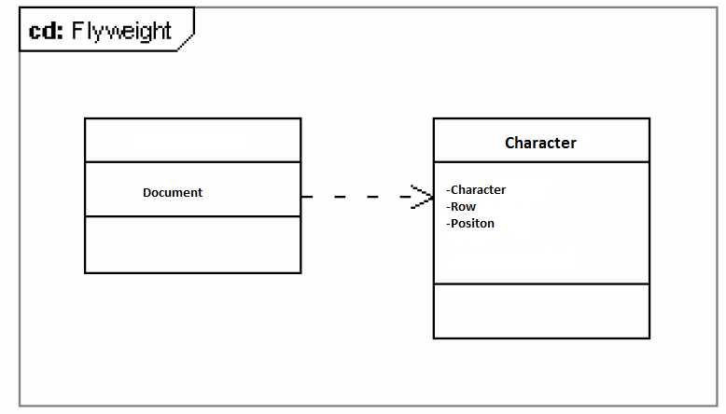
Normal Model

Slide 5
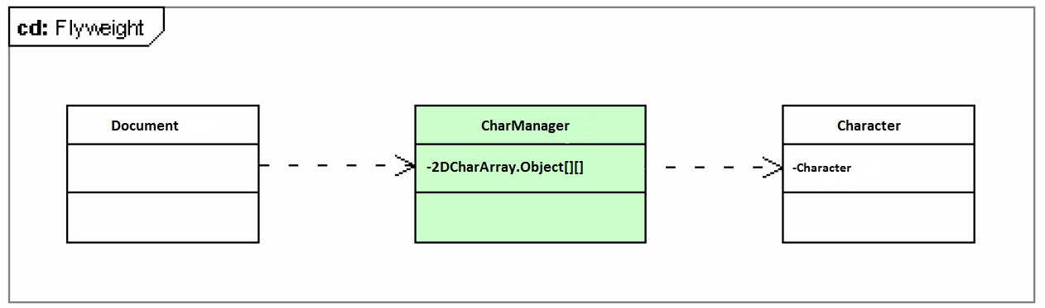
Flyweight Model

Slide 6
The End

